Slide 1

Big Data Project
Open University learning Analytics Dataset
(OULAD)

Slide 2
Contents
Data Understanding/ Overview
Data Pre-Processing and Data Cleaning
Exploratory Data Analysis (EDA)
Data Modelling
Conclusion

Slide 3
Team Navy
Navyashree Byregowda Computer science engineering
Krishan Kumar
computer science engineering
Anas Nazeer Khan Information technology

Slide 4
Description
Open University is a public British University that also has the highest number of undergraduate students in the UK. It is the largest academic institution in the United Kingdom (and one of the largest in Europe) with 2 Million enrolled students since it is established at 1969. As can be understood from its name, Open University mainly populated by off-campus students.
Content
This dataset belongs to Open University Online Learning Platform (Also called as "Virtual Learning Environment(VLE)") that off-campus students use for accessing the course content, forum discussions, sending assessments and checking out assignment marks etc. It consists of 7 selected courses (mentioned as modules in the dataset). Different presentations indicated with letters "B" and "J" after year for semester 2 and semester 1 respectively.
Additionally, the dataset includes student demographics such as location, age group, disability, education level, gender etc. Student assessment marks, interactions with the Virtual Learning Environment (VLE) are also included.

Slide 5
Datasets
studentInfo.csv
courses.csv
assessments.csv
studentAssessment.csv
studetRegistration.csv
vle.csv

Slide 6
Datasets Overview
studentInfo.csv – This file contains demographic information about the students together with their results. File contains the following columns:
code_module – an identification code for a module on which the student is registered.
code_presentation - the identification code of the presentation during which the student is registered on the module.
id_student – a unique identification number for the student.
gender – the student’s gender.
region – identifies the geographic region, where the student lived while taking the module-presentation.
highest_education – highest student education level on entry to the module presentation.
imd_band – specifies the Index of Multiple Depravation band of the place where the student lived during the module-presentation.
age_band – band of the student’s age.
num_of_prev_attempts – the number times the student has attempted this module.
studied_credits – the total number of credits for the modules the student is currently studying.
disability – indicates whether the student has declared a disability.
final_result – student’s final result in the module-presentation.
courses.csv – File contains the list of all available modules and their details. The columns are:
code_module – code name of the module, which serves as the identifier.
code_presentation – code name of the presentation. It consists of the year and “B” for the presentation starting in February and “J” for the presentation starting in October.
length - length of the module-presentation in days.

Slide 7
Datasets Overview
assessments.csv – This file contains information about assessments in module-presentations. Usually, every presentation has several assessments followed by the final exam. The columns are:
code_module – identification code of the module, to which the assessment belongs.
code_presentation - the identification code of the presentation during which the student is registered on the module.
id_assessment – identification number of the assessment.
assessment_type – type of assessment. Three types of assessments exist: Tutor Marked Assessment (TMA), Computer Marked Assessment (CMA) and Final Exam (Exam).
date – information about the final submission date of the assessment calculated as the number of days since the start of the module-presentation. The starting date of the presentation has number 0 (zero).
weight - weight of the assessment in %. Typically, Exams are treated separately and have the weight 100%; the sum of all other assessments is 100%. If the information about the final exam date is missing, it is at the end of the last presentation week.
studentAssessment.csv - Contains student assessment scores. This file contains the following columns:
id_assessment – the identification number of the assessment.
id_student – a unique identification number for the student.
date_submitted – the date of student submission, measured as the number of days since the start of the module presentation.
is_banked – a status flag indicating that the assessment result has been transferred from a previous presentation.
score – the student’s score in this assessment. The range is from 0 to 100. The score lower than 40 is interpreted as Fail. The marks are in the range from 0 to 100.

Slide 8
Datasets Overview
studetRegistration.csv - Contains information on the Student registration for different modules. File contains five columns:
code_module – identification code of the module, to which the assessment belongs.
code_presentation - the identification code of the presentation during which the student is registered on the module.
id_student – a unique identification number for the student.
date_registration – the date of student’s registration on the module presentation, this is the number of days measured relative to the start of the module-presentation (e.g. the negative value -30 means that the student registered to module presentation 30 days before it started).
date_unregistration – date of student un-registration from the module presentation, this is the number of days measured relative to the start of the module-presentation.
vle.csv – The studentVle.csv file contains information about each student’s interactions with the materials in the VLE. This columns are:
code_module – an identification code for a module.
code_presentation - the identification code of the module presentation.
id_student – a unique identification number for the student.
id_site - an identification number for the VLE material.
date – the date of student’s interaction with the material measured as the number of days since the start of the module-presentation.
sum_click – the number of times a student interacts with the material in studentVle.csv

Slide 9
Data Pre-processing and Data Cleaning

Slide 10
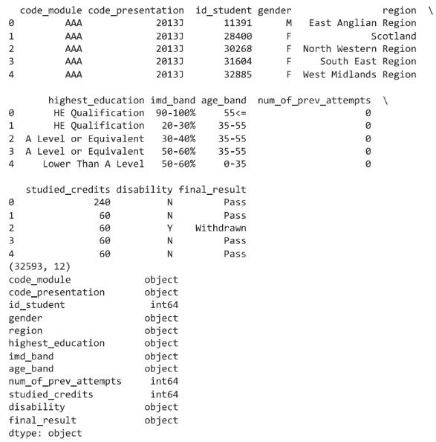
Data Pre-Processing
These steps are crucial for accessing and preparing the necessary data for further analysis and visualization in our project report.

Slide 11
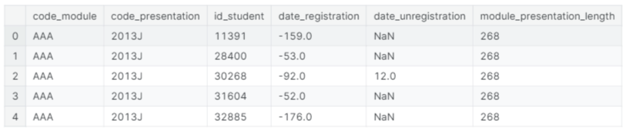
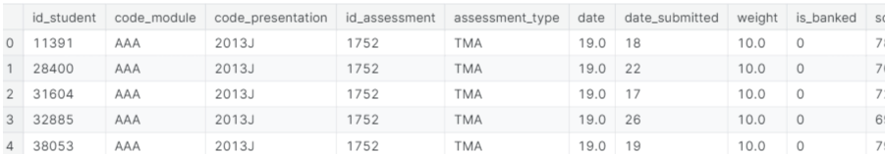
Data
Integration
Registration info + Courses + Info
Merging the tables using code_module and code_presentation as the primary key to the store data. As per StudentAssessment dataset we do not find code_module and code_presentation hence we use id_student and id_assessment attritube to combine the data merging so we can analyse data is better way.
Assessment info + Assessment Results

Slide 12
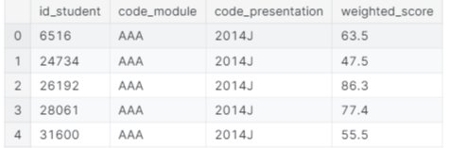
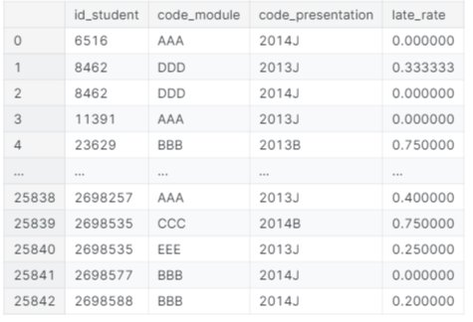
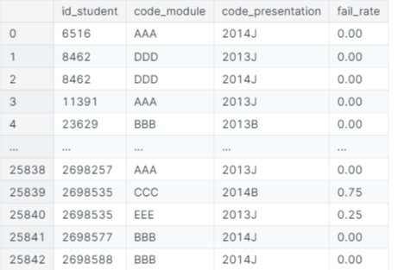
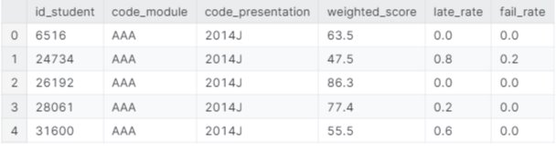
MERGING
Weighted score
Multiply the weight of the assignment with its score.
Aggregate the dataframe per weight*score per module per module presentation with the sum function.
Calculate total recorded weight of module (recorded total is key here as most modules are missing their final exam).
Now calculate weighted scores - divide summed weight*score by total recorded weight of module.
late rate & fail rate Calculate the difference between the deadline and the actual submission date.
Make a new column - if the difference between dates is more that ), the submission was late.
Aggregate by student ID, module, and module presenation. By mering all 3 tables, we form resultant which provides info about assessment

Slide 13
Split Data Set
It's crucial to split the dataset before conducting any serious exploratory analysis to avoid any bias that could arise from peeking at the testing data. This ensures that our insights and models are evaluated on truly unseen data. When we proceed with pre-processing and further feature engineering, we will apply the same parameters and transformations to both the training and testing sets to maintain consistency.
To ensure fair representation across different categories, we will stratify by the code module. This stratification guarantees that each module is equally represented in both the training and testing sets, which helps in maintaining the distribution and variability of the data across these sets.
split the dataset into training and testing sets.

Slide 14
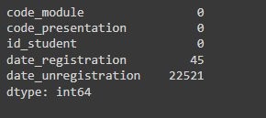
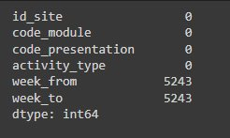
Data Cleaning
Student registration dataset
Variable Reduction: To streamline the dataset and concentrate the analysis on pertinent variables, unnecessary variables This method simplifies the dataset and enhances the focus on essential factors for analysis.
In order to get ride of the extra load on memory, these columns will be dropped.
Approach mitigates the risk of biases or inaccuracies stemming from incomplete data, thereby bolstering the robustness of subsequent analyses.
VLE data set

Slide 15
EXPLORATORY DATA ANALYSIS (EDA)

Slide 16
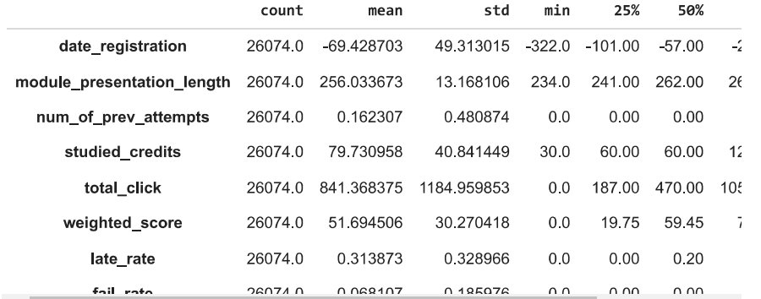
Univariate Analysis Statistical technique used to analyze and summarize a single variable or feature of a dataset. It involves describing the distribution of the variable, identifying patterns, and calculating various statistics to understand its characteristics.
Exploratory Data Analysis (EDA)

Slide 17
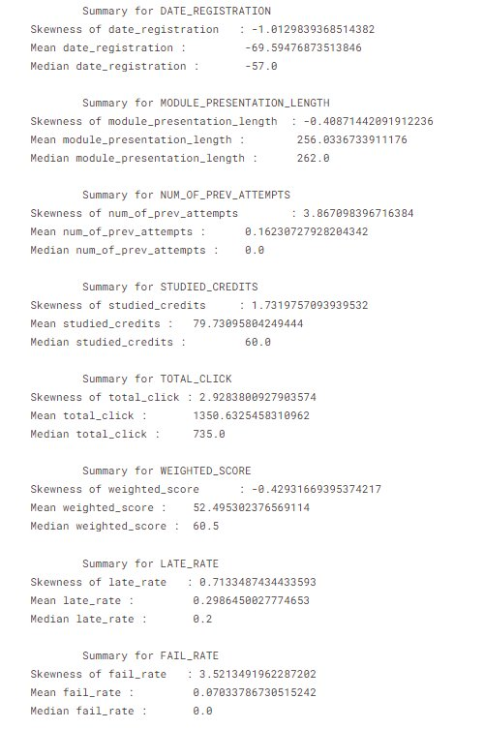
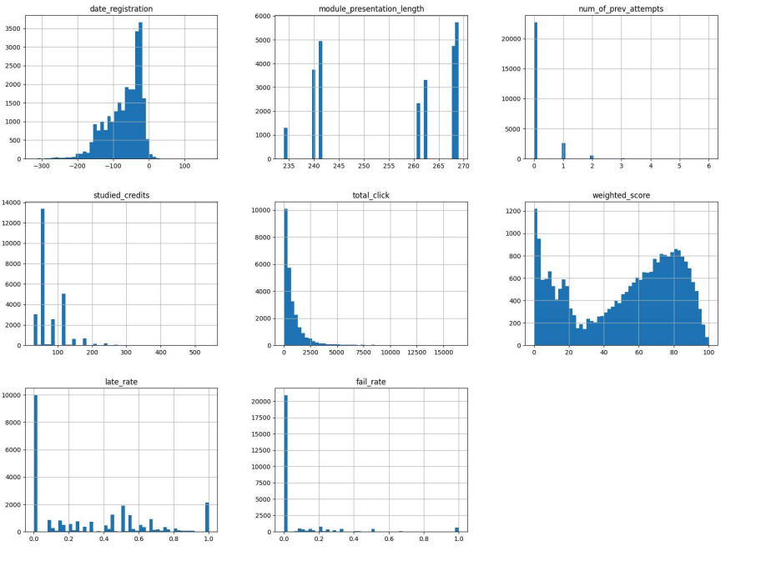
Univariate analysis FIG 1 - Distribution plot statistics summaries with skew, mean, and median Produce a dataframe with just numerical columns Fig 2 - histogram graph

Slide 18
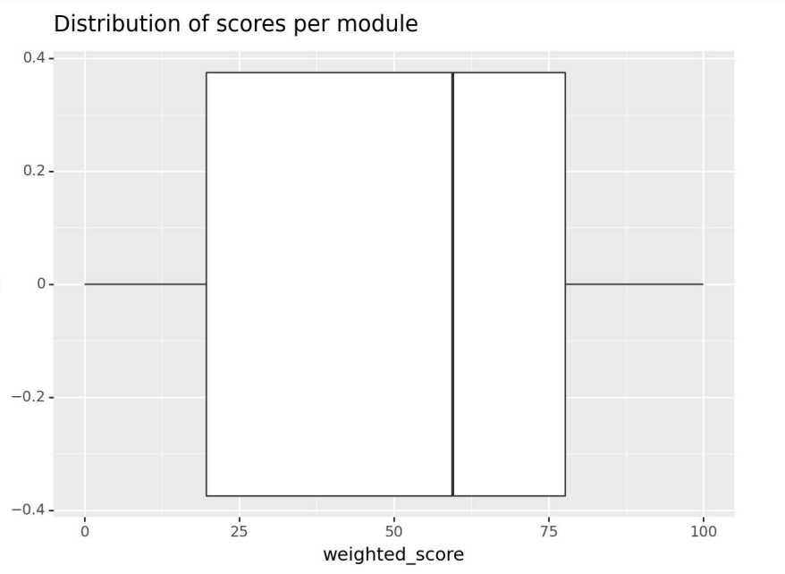
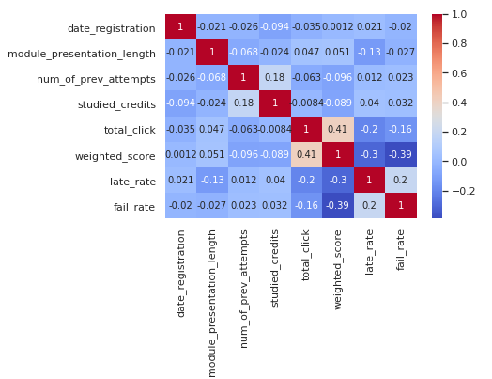
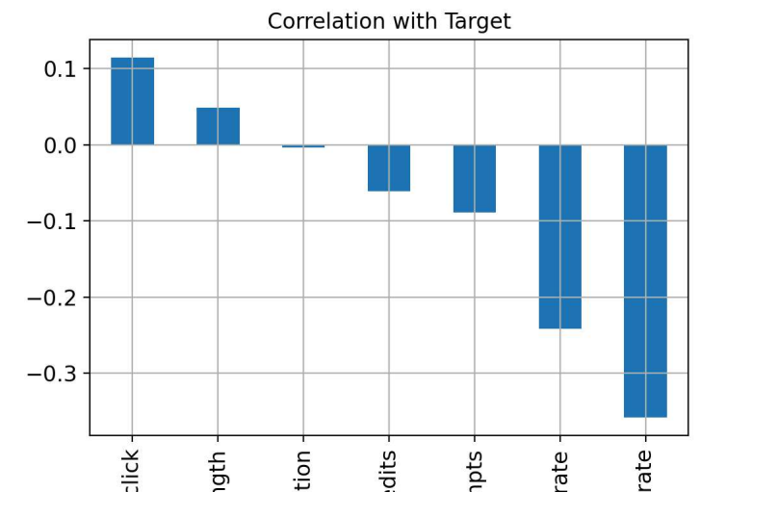
Target variable - weighted score
We can see the target variable has two peaks and is not normally distributed, but it doesn't have any outliers. We may wish to transform the target at some point to improve our models. This notebook shows very basic acanalysis though, so we will not be doing this, but it's something to keep in mind when using certain models (like the linear regression that assumes the distributions are normal).
Correlation matrix
This can show us that there is little colinearity among the variables. Let's have a closer look at linear correlations between features and the target.

Slide 19
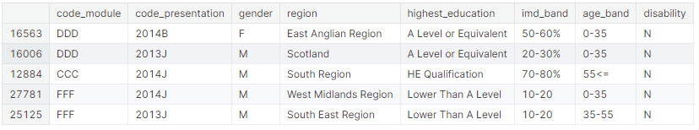
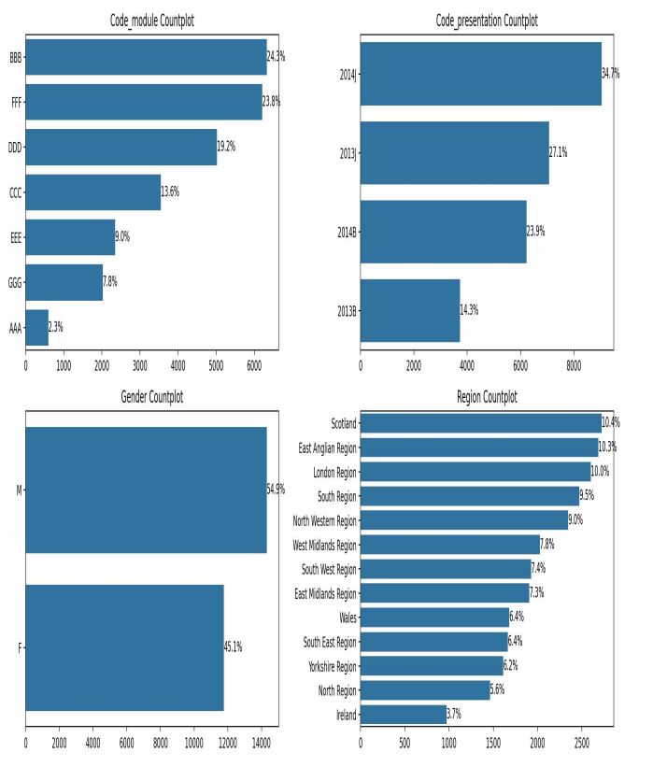
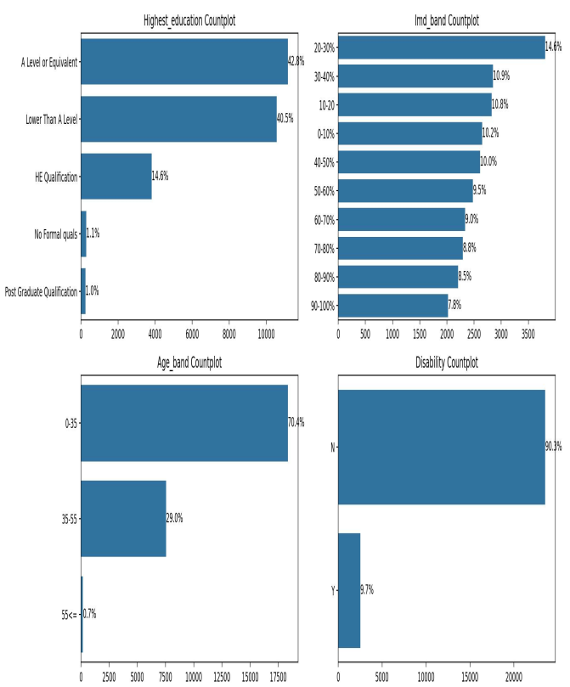
Univariate analysis: categorical data
Very few students with no formal education (1%)
Very few students with post-grad qualifications.
These two categories should be merged with 'Lower Than A Level' and 'HE Qualification', respectivelly, as with so little data these two categories are not likely to bring much insight

Slide 20
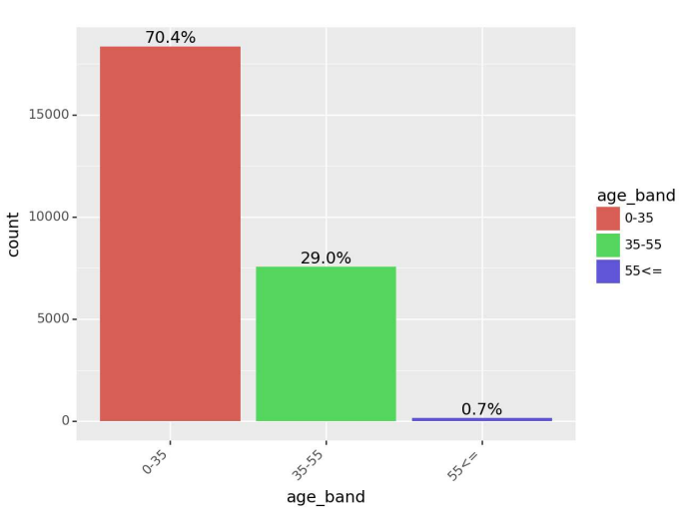
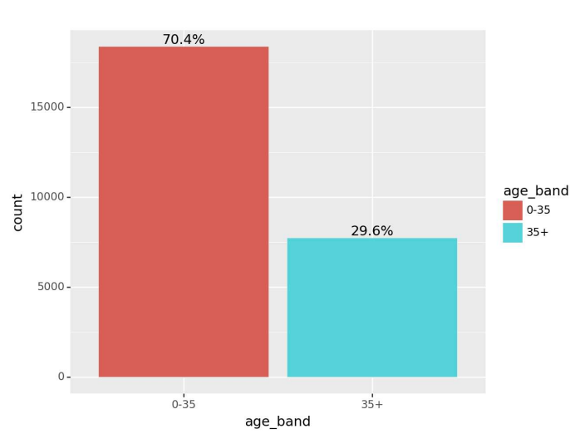
Univariate analysis: categorical data
Change education categories
Change age categories

Slide 21
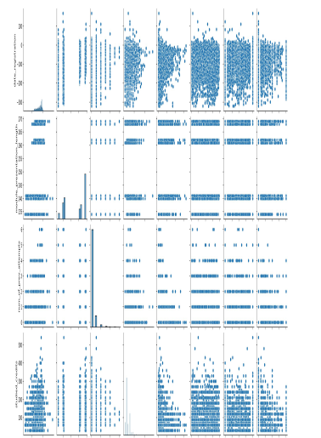
Bivarient analysis: numerical
final scores vs other variables
Conclusion
The results are vague. There doesn't seem to be any strong relationships between any variables and the target except, perhaps, the number of total clicks

Slide 22
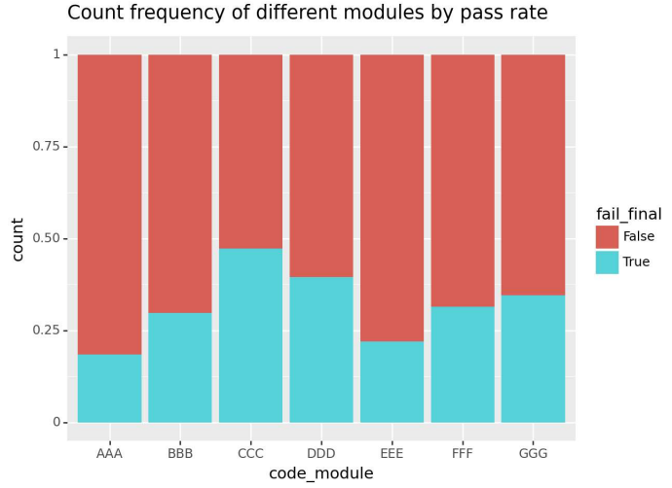
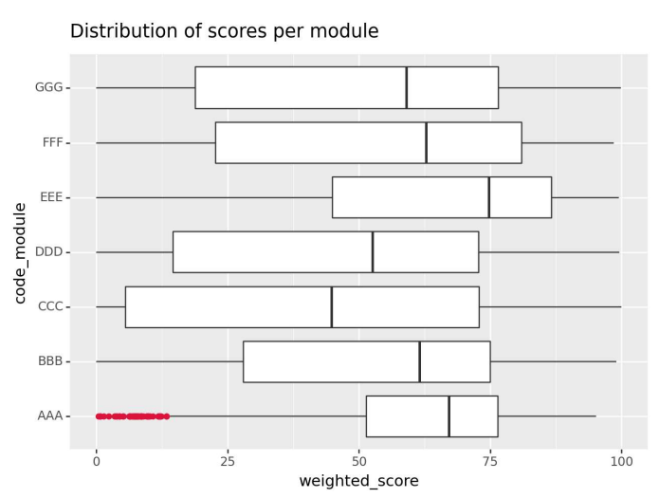
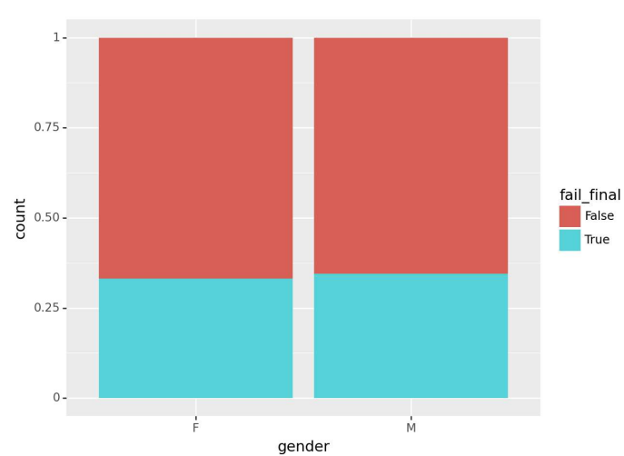
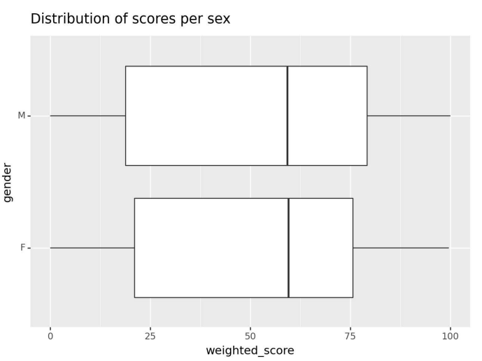
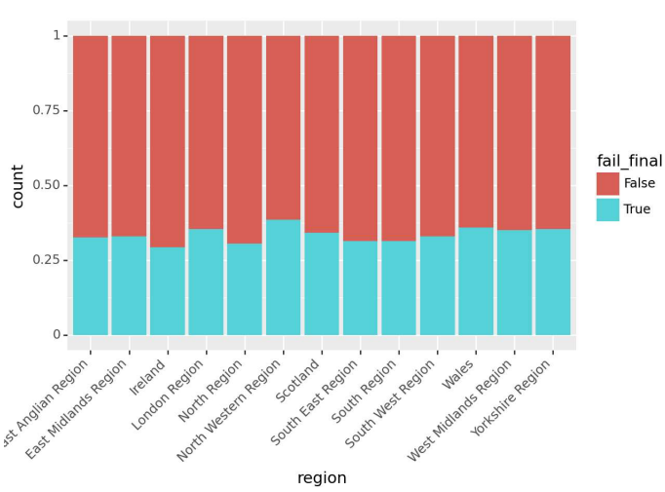
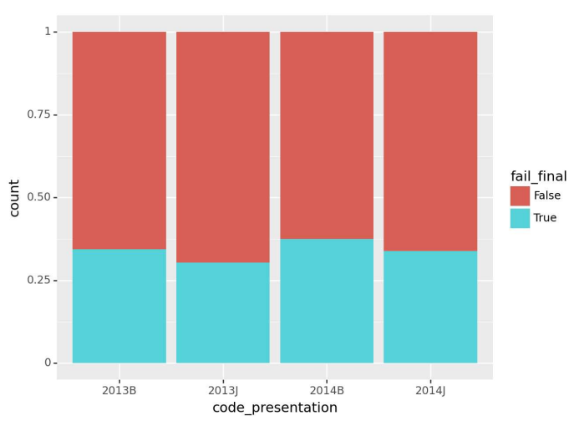
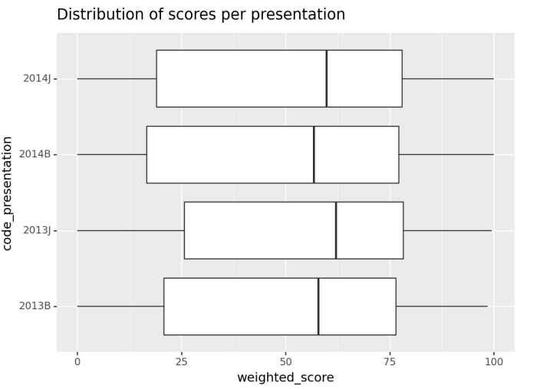
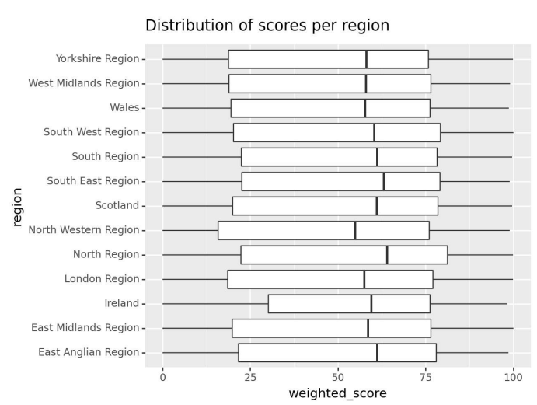
Bivarient analysis :catergorical Let's make a helper column to indicate if the student failed or not so we can compare categorical variables for failed and passing students.

Slide 23
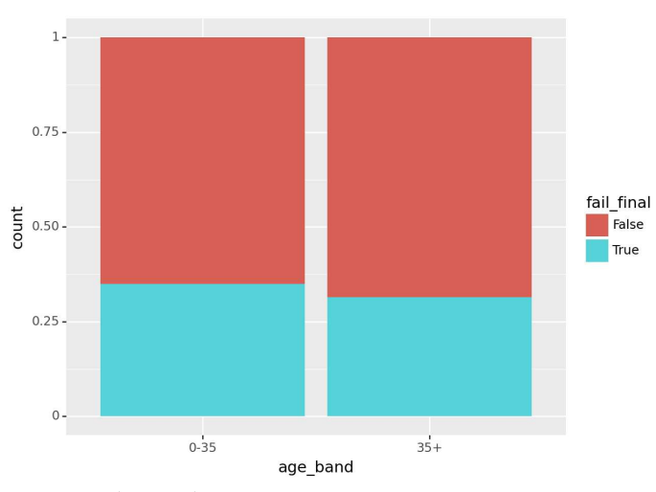
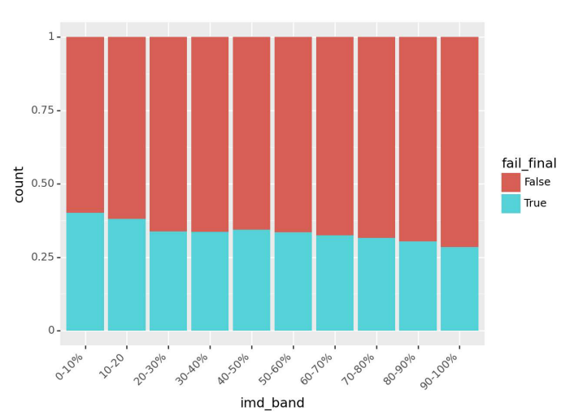
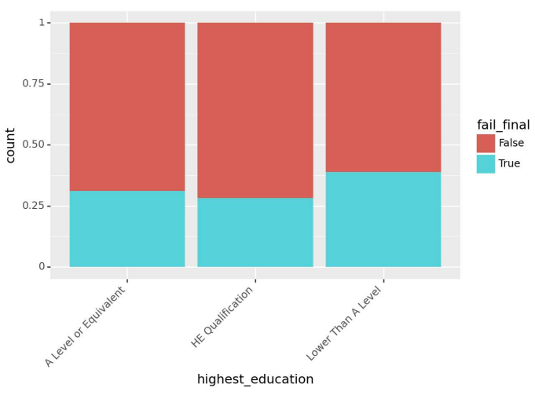
Bivarient analysis:catergorical

Slide 24
Data Modelling

Slide 25
Linear Regression
Linear regression is most likely going to be a bad model as the data breaks several of the assumptions of this model.
The assumptions are as follows:
Linear relationship between the target and features - The pair plots show this isn't the case.
Multivariate normality - all variables must be normal. The histograms of the numerical variables show that their distributions aren't normal.
Little to no multicollinearity - all variables must be independent from each other. The correlation matrix shows that this isn't so.
No auto-correlation - when the value of y(x+1) is independent from the value of y(x).
Homoscedasticity - residuals must be equal along the regression line. Linear regression can show us an example of a bad model, showing how other models can vastly improve the predictions.

Slide 26
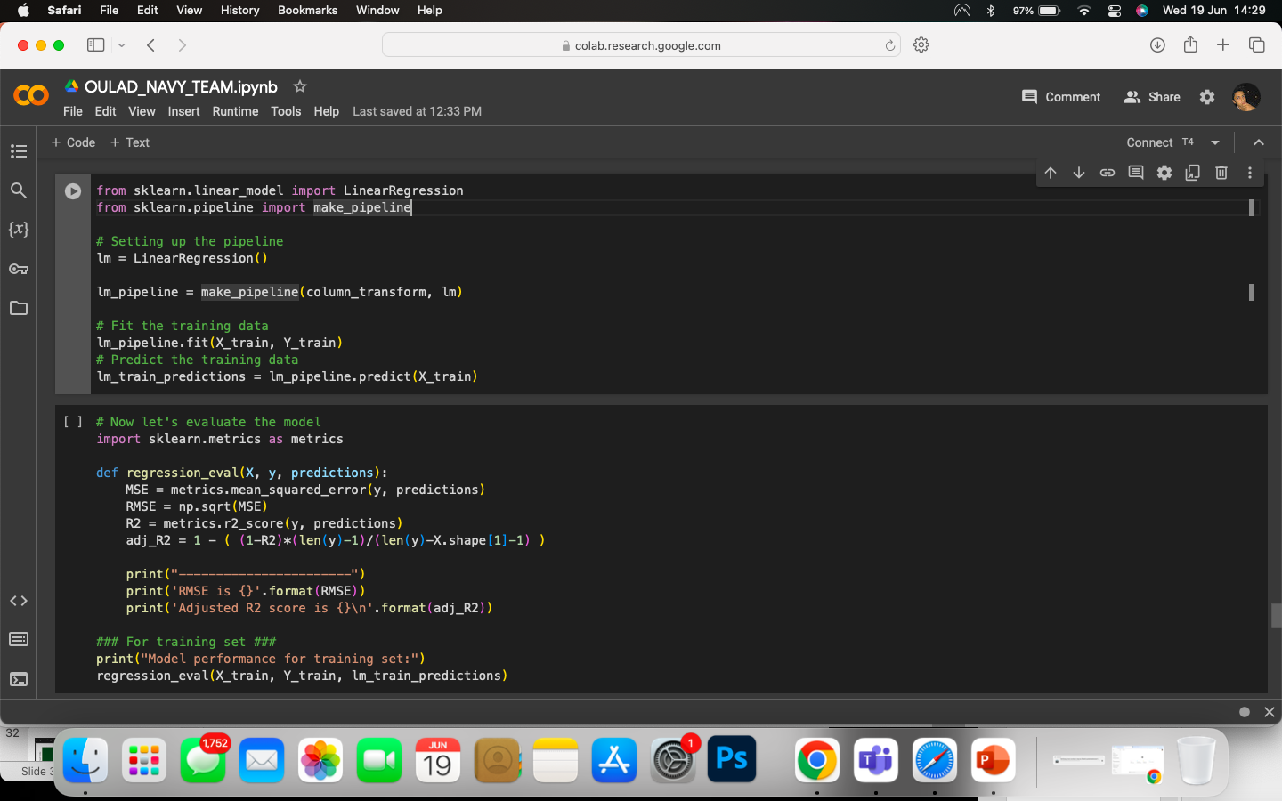
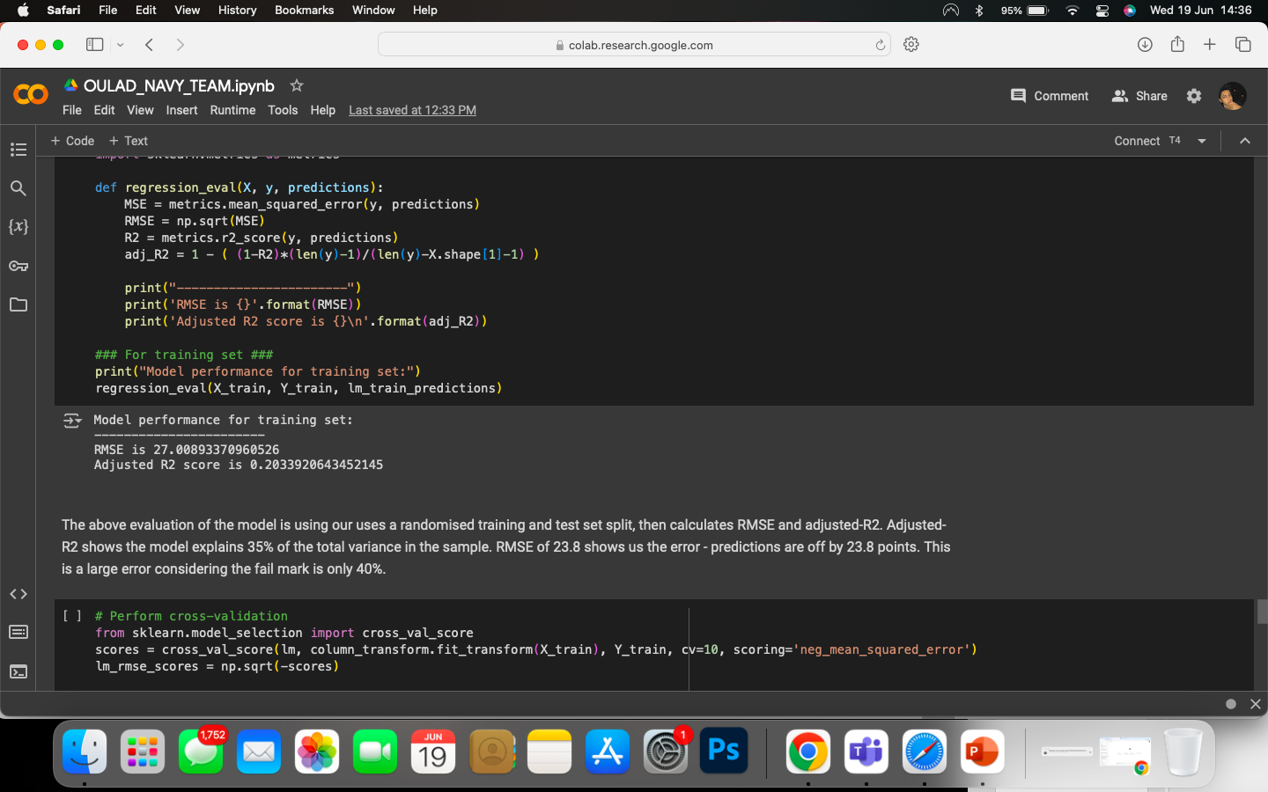
The model uses a randomized training and test set split, then calculates RMSE and adjusted-R2.
Adjusted-R2 shows the model explains 35% of the total variance in the sample.
RMSE of 23.8 shows us the error - predictions are off by 23.8 points.
This is a large error considering the failure mark is only 40%.

Slide 27
Decision Tree
This model uses a very different approach - building a what is essentially a flow chart based on probabilities and likelihoods.
It is a simple algorithm with many models using it as a base algorithm (e.g. Random Forest).

Slide 28
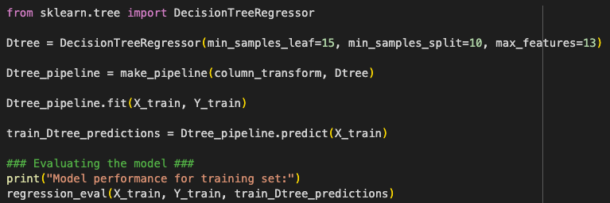
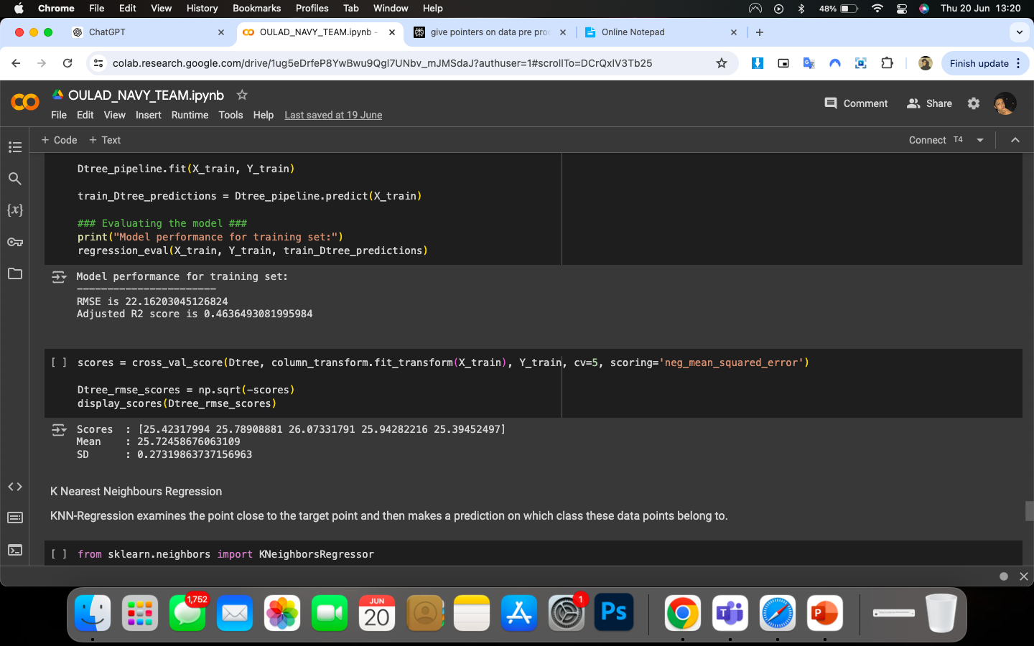

Training Set Performance: The Decision Tree model achieves an RMSE of 22.162 on the training set, indicating that the model's predictions are on average 22.162 units away from the actual values. The Adjusted R2 score of 0.4636 indicates a moderate fit, explaining approximately 46.36% of the variance in the training data.
Cross-Validation Performance: The cross-validation scores suggest that the model's performance is consistent across different subsets of the data. The mean RMSE of 25.725 and the low standard deviation (0.273) indicate that the model performs reliably and its predictions are relatively stable.

Slide 29
K-Nearest Neighbors
KNN-Regression examines the point close to the target point and then makes a prediction on which class these data points belong to.

Slide 30
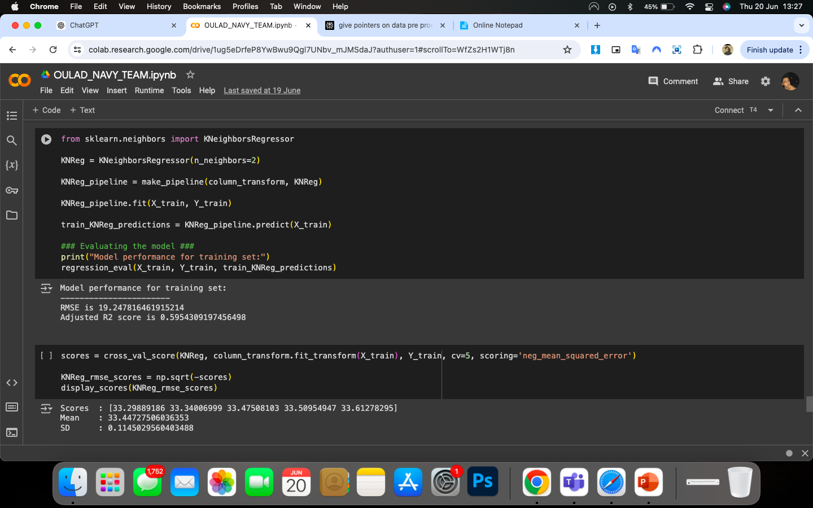
Training Set Performance: The KNN model achieves an RMSE of 19.248 on the training set, indicating that the model's predictions are, on average, 19.248 units away from the actual values. The Adjusted R2 score of 0.5954 indicates a good fit, explaining approximately 59.54% of the variance in the training data.
Cross-Validation Performance: The cross-validation scores suggest that the model's performance is consistent across different subsets of the data. The mean RMSE of 33.447 and the low standard deviation (0.115) indicate that the model performs reliably and its predictions are relatively stable.

Slide 31
Random Forest
The Random Forest algorithm is an ensemble learning method that is widely used for both classification and regression tasks. It operates by constructing multiple decision trees during training and outputting the class (classification) or mean prediction (regression) of the individual trees.

Slide 32
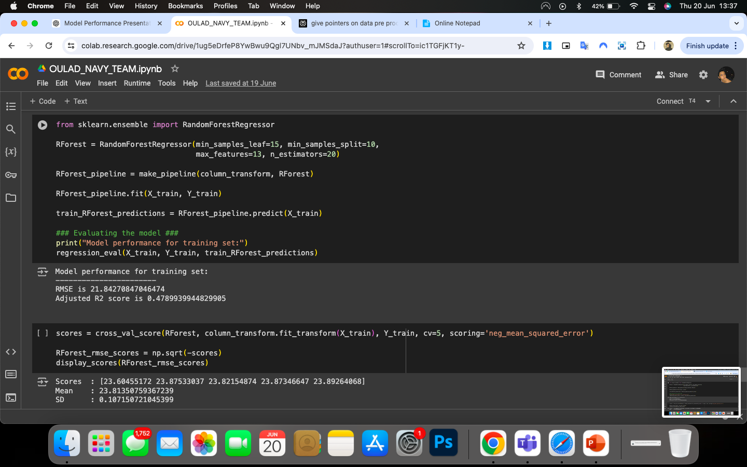
Training Set Performance: The Random Forest model achieves an RMSE of 21.843 on the training set, indicating that the model's predictions are, on average, 21.843 units away from the actual values. The Adjusted R2 score of 0.479 indicates a moderate fit, explaining approximately 47.9% of the variance in the training data.
Cross-Validation Performance: The cross-validation scores suggest that the model's performance is consistent across different subsets of the data. The mean RMSE of 23.814 and the low standard deviation (0.107) indicate that the model performs reliably and its predictions are relatively stable.

Slide 33
Support Vector Regression
Linear models are doing badly, as expected. We will next use non-linear models and see if our predictions improve.
Support Vector Regression seeks not to minimise the squared error as in the linear regression, but to minimise coefficients.

Slide 34
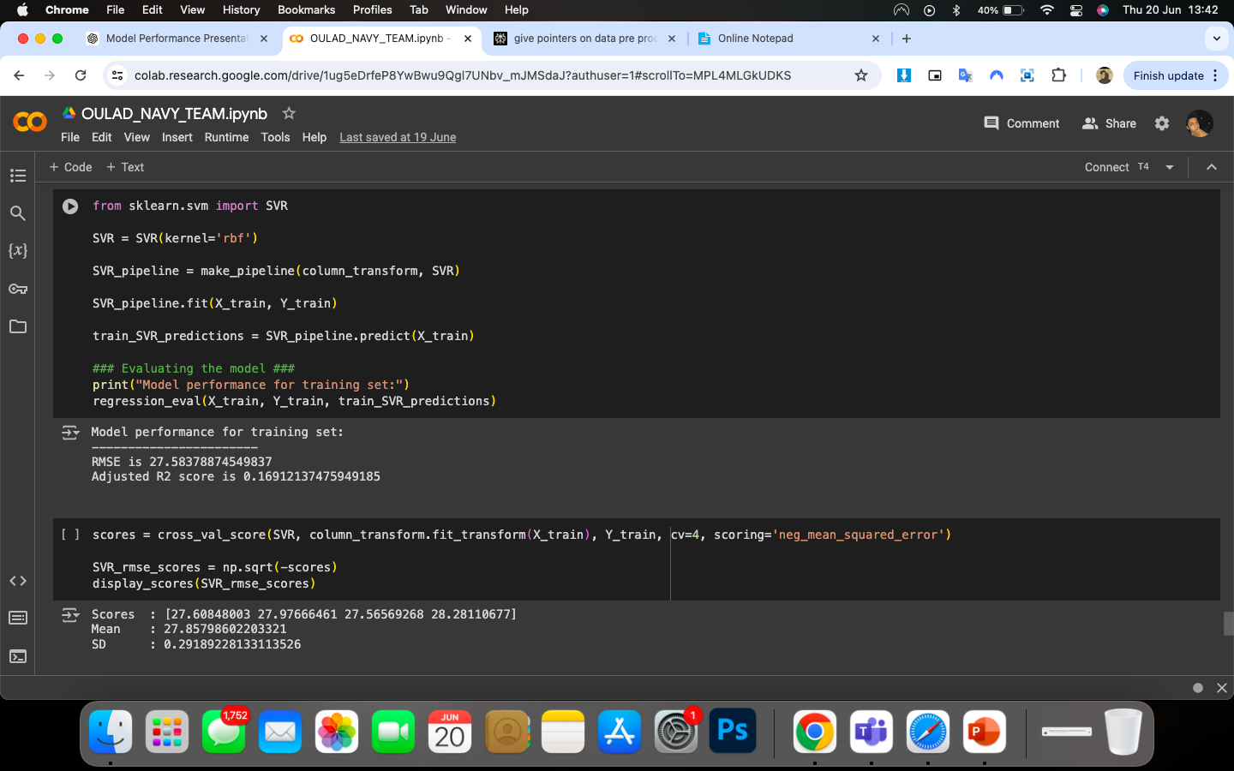
Training Set Performance: The SVR model achieves an RMSE of 27.584 on the training set, indicating that the model's predictions are, on average, 27.584 units away from the actual values. The Adjusted R2 score of 0.169 indicates a poor fit, explaining only approximately 16.91% of the variance in the training data.
Cross-Validation Performance: The cross-validation scores suggest that the model's performance is consistent across different subsets of the data. The mean RMSE of 27.858 and the low standard deviation (0.292) indicate that the model performs reliably and its predictions are relatively stable.

Slide 35
Classification Models

Slide 36
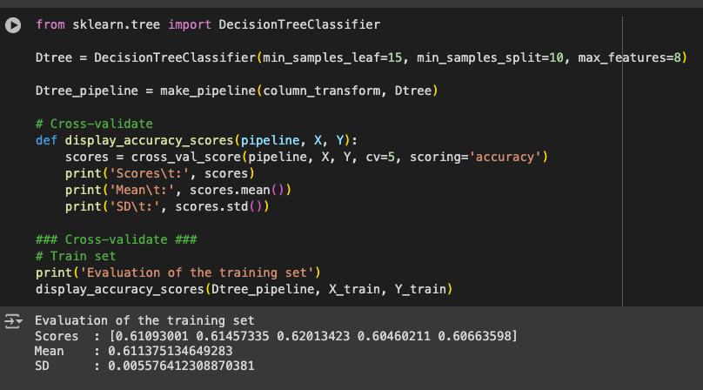
Decision Tree
Training Set Performance: The Decision Tree Classification model achieves an average accuracy score of 0.6114 (61.14%) on the training set, indicating that the model correctly classifies around 61.14% of the instances. The consistency of the scores across different folds, as indicated by the low standard deviation (0.0056), suggests that the model's performance is stable and reliable.

Slide 37
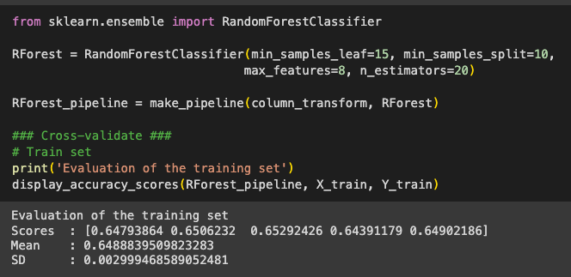
Random Forest
Training Set Performance: The Random Forest Classification model achieves an average accuracy score of 0.6489 (64.89%) on the training set, indicating that the model correctly classifies around 64.89% of the instances. The consistency of the scores across different folds, as indicated by the low standard deviation (0.0030), suggests that the model's performance is stable and reliable.

Slide 38
Conclusion

Slide 39
Final Modelling
Best Model for Regression Task - Support Vector
The best model for the regression task was support vector (RMSE = 18.4, SD = 0.2 with 4-fold cross-validation) which gave us RMSE = 18.1 and adjusted R2 = 0.63 when evaluated on the test set.
This is without any fine-tuning of the hyperparameters.
Best Model for Classification Task – Random Forest Classifier
Random forest classifier model performed the best. Althrough its accuracy scores (0.64, SD = 0.002) .

Slide 40
Next Steps/ Future Improvements
﻿﻿Next steps to take would be to find which features are most important and which can be dropped.
Hyperparameter tuning can be used to find the best set of parameters for the models.
﻿﻿Various dimensionality reduction tools can be used to improve the performance of the models.
Another point to make is that accuracy score isn't the best way to evaluate classification models, especs when the target is imbalanced.
We have an imbalanced target for this classification problem, so dealing with this imbalance and using a different evaluation metric would be advantageous.

